Slide 1
/
SS-TPT: Stability and Suitability-Guided Test-Time Prompt Tuning for Adversarially Robust Vision-Language Models
prepared by
Abhishek Nair 23009
Kshetrimayum Paresh Singh 23160
Kushagra Agarwal 23162
10th November 2026

Slide 2
/
Contents
01
Introduction
02
Methodology
03
Model Architecture
04
Task 1
05
Task 2
06
Results
07
Conclusion

Slide 3
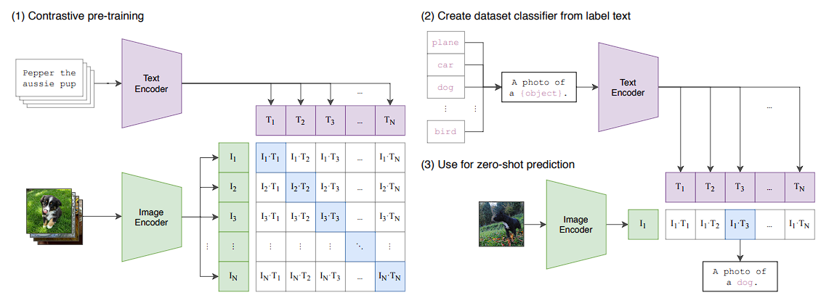
/
Introduction
Background:
  Vision-Language Models learn joint representations of visual and textual information.
  They establish semantic relationships between images and natural language descriptions.
  They enable zero-shot image classification without requiring task-specific training data.
CLIP:
  CLIP consists of two independent encoders:
    Image Encoder – extracts visual features from an input image.
    Text Encoder – extracts semantic features from textual descriptions.
  Both encoders map their inputs into a shared embedding space.
  Image and text representations are compared using cosine similarity to determine their semantic correspondence.
  However, their predictions can be unreliable under adversarial perturbations and distribution shifts.

Slide 4
/
Motivation
1. Vulnerability to Adversarial Perturbations
  Pre-trained VLMs such as CLIP can be vulnerable to carefully crafted adversarial perturbations.
  Small, intentional modifications to input images can significantly alter model predictions.
  This compromises the reliability of zero-shot image classification.
2. Limitations of Existing Test-Time Adaptation Methods
  Test-Time Adaptation (TTA) attempts to improve model predictions by adapting the model during inference.
  Existing approaches often generate multiple augmented views of an input image.
  However, not all augmented views provide reliable information.
  Treating unreliable and trustworthy views equally can negatively affect adaptation and prediction.
3. Computational Overhead
  Processing numerous augmented views increases computational requirements.
  This creates a trade-off between adversarial robustness and inference efficiency.

Slide 5
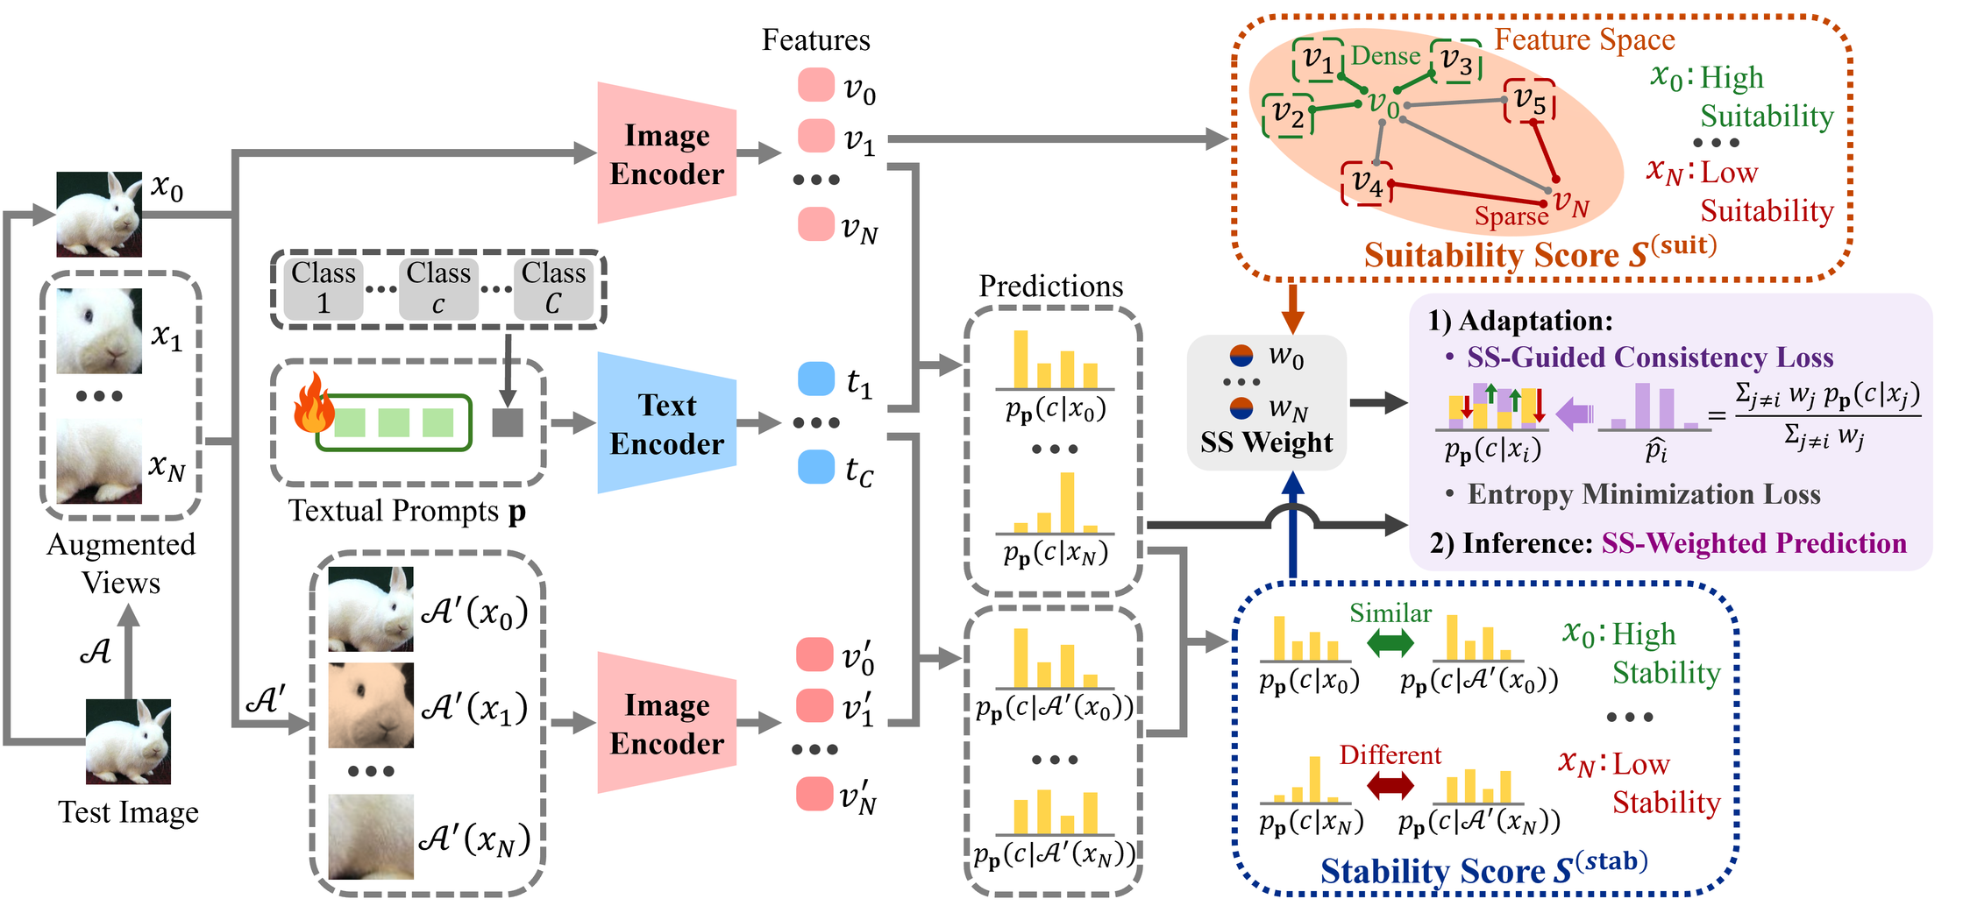
/
Model Architecture

Slide 6
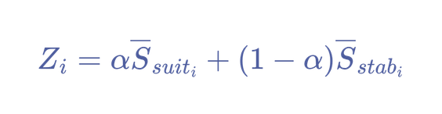
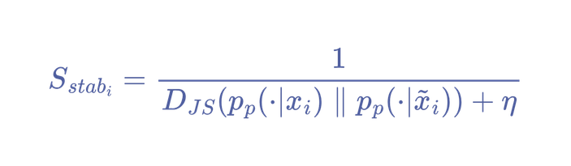
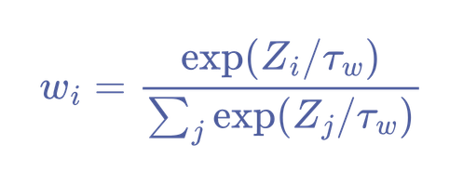

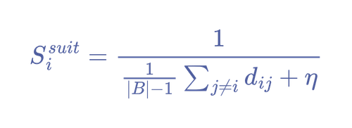




/
Methodology
SS-TPT generates multiple augmented views and extracts their prediction distributions and image feature representations using CLIP for a given test image. It evaluates each view using two complementary reliability scores.
The two reliability scores are independently Min-Max normalized and combined to calculate an overall SS score.
/Combined SS Score:
The SS scores are converted into normalized weights using softmax.
/SS Weight:
: Balances Stability and Suitability.
: Softmax temperature.
Higher SS weight indicates a more trustworthy view.
/Stability:
Measures prediction invariance between an augmented view and its weakly augmented counterpart.
: Jensen-Shannon divergence
/Suitability:
Measures how well a view fits within the feature-space distribution of other augmented views.
: L2-normalized image features
: Cosine-derived feature distance

Slide 7
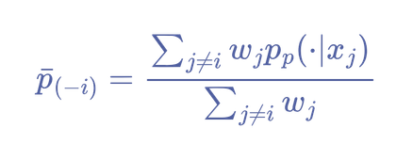
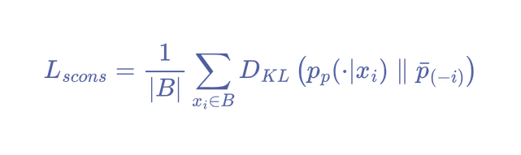
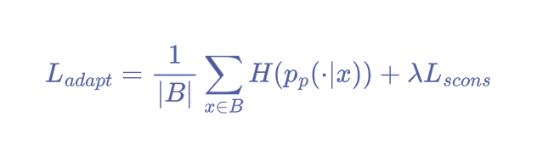
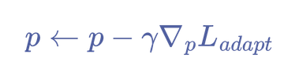
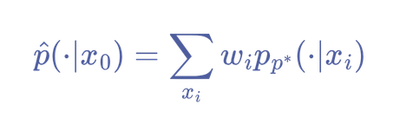
/
SS-Guided Adaptation and Prediction
SS-TPT uses the calculated weights to guide prompt adaptation and final inference.
A. SS-Guided Consistency Loss
For each view, a Leave-One-Out (LOO) reference prediction is calculated using the weighted predictions of all other views.
The consistency loss aligns each view's prediction with this reliable reference.
B. Overall Adaptation Objective
Combines Point-wise Entropy Minimization with SS-guided Consistency Loss.
The learnable prompts are updated through gradient descent:
C. SS-Weighted Prediction
After prompt adaptation, the final prediction is obtained by aggregating predictions from all views using their SS weights.

Slide 8
/
Task 1
01
02
03
04
Understand
Position
Activate
Optimize
Research the audience, market, and current brand presence.
Define a clear message and creative direction.
Launch engaging content across relevant digital channels.
Monitor performance and refine the campaign along the way.

Slide 9
/
Task 2
Strategy
/
Creative
/
Activation
Audience research
  Campaign concept
  Social media
Market analysis
  Visual direction
  Paid advertising
Campaign strategy
  Content development
  Performance tracking

Slide 10
/
Project Timeline
01
02
03
04
/
/
/
/
Discover
Create
Launch
Review
Week 01–02
Week 03–04
Week 05–06
Week 07–08
Research the market, audience, and brand to define the project direction.
Develop the campaign concept, visual direction, and content strategy.
Bring the campaign to life across selected digital channels.
Review performance and refine the campaign for better results.

Slide 11
/
Deliverables
Campaign Strategy
Creative Assets
Strategic direction
and campaign framework.
Key visuals and digital campaign materials.
Social Media Content
Performance Report
Branded content for
selected social channels.
Campaign results, insights,
and recommendations.

Slide 12
10th November 2026
/
Thank
You
prepared by
Creative Lab
@reallygreatsite
www.reallygreatsite.com

